Slide 1

Data MJB
Real Estate Market
Xuya Jiang, Yanbin Liu, Weili He
Ruitong Zhu, Avyay Sah, Tony Nie

Slide 2
Introduction
Project Introduction
Model Description
User
Market Review
& Analysis
Data Resources
Accuracy

Slide 3
Market Analysis
Zillow Zestimate: statistical and machine learning models to estimate home prices.
Shanghai is one of the largest housing markets, attracting investments from investors and homebuyers
There is a demand for models to provide price prediction for Shanghai

Slide 4
Objective
Analyze the historical price impact on the Shanghai real estate market price
Demonstrate all the factors that will have impact on the price
Show the expected price for the specific needs from the customers

Slide 5
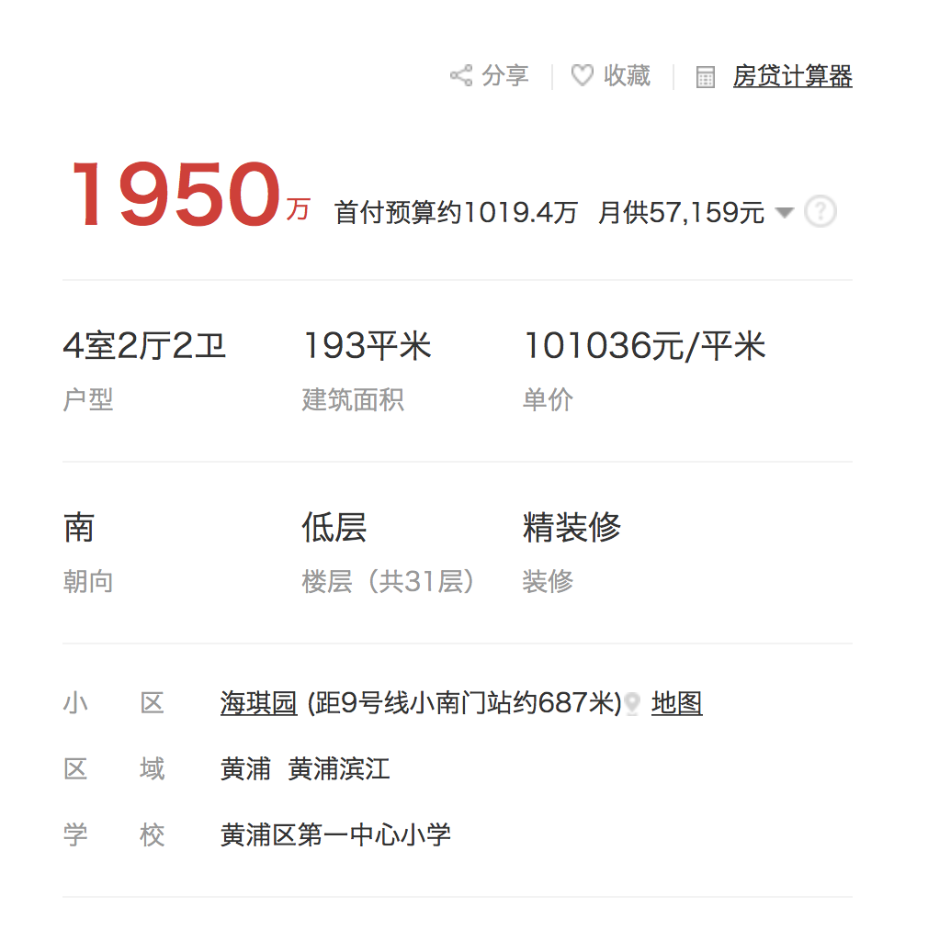
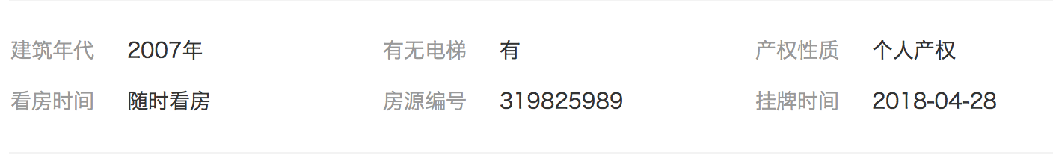
DATA DESCRIPTION
≈$16,000
Price
per square meter (in RMB)
Notes:
Our data is mainly scripted from a website called fang.com, and im gonna illustrate how we utilize the website to get the data. Let’s take this screen shot as an example. We have two price here, but according to the literatures, we are not using the total price, but price per square meter as the dependent variable in our model. And in this example, the price is a hundred thousand yuan, which is 16 thousand in us dollars.
Other features shown in the figure are expalnatory variables, i’m gonna talk about some of them in detail, and quickly go through others.

Slide 6
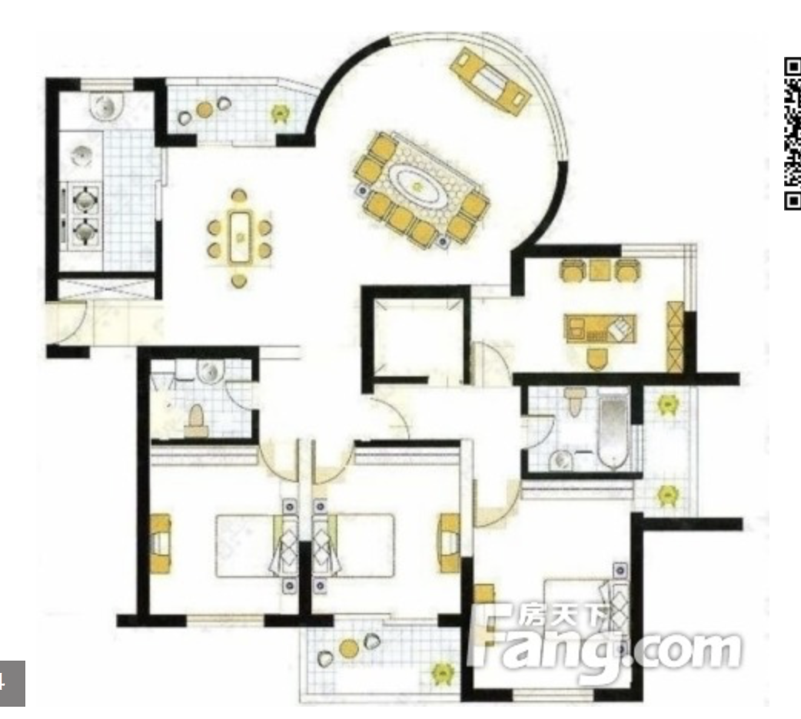
DATA DESCRIPTION
Floor plan
# of bedroom: 4
# of living room : 2
# of bathroom: 2
Total floor area: 193
Notes:
First is the information on the floor plan. From the blue circle, we can derive the number of bedrooms, which is 4, ….The red circle, indicates the total floor area, which is 193 square meters.

Slide 7
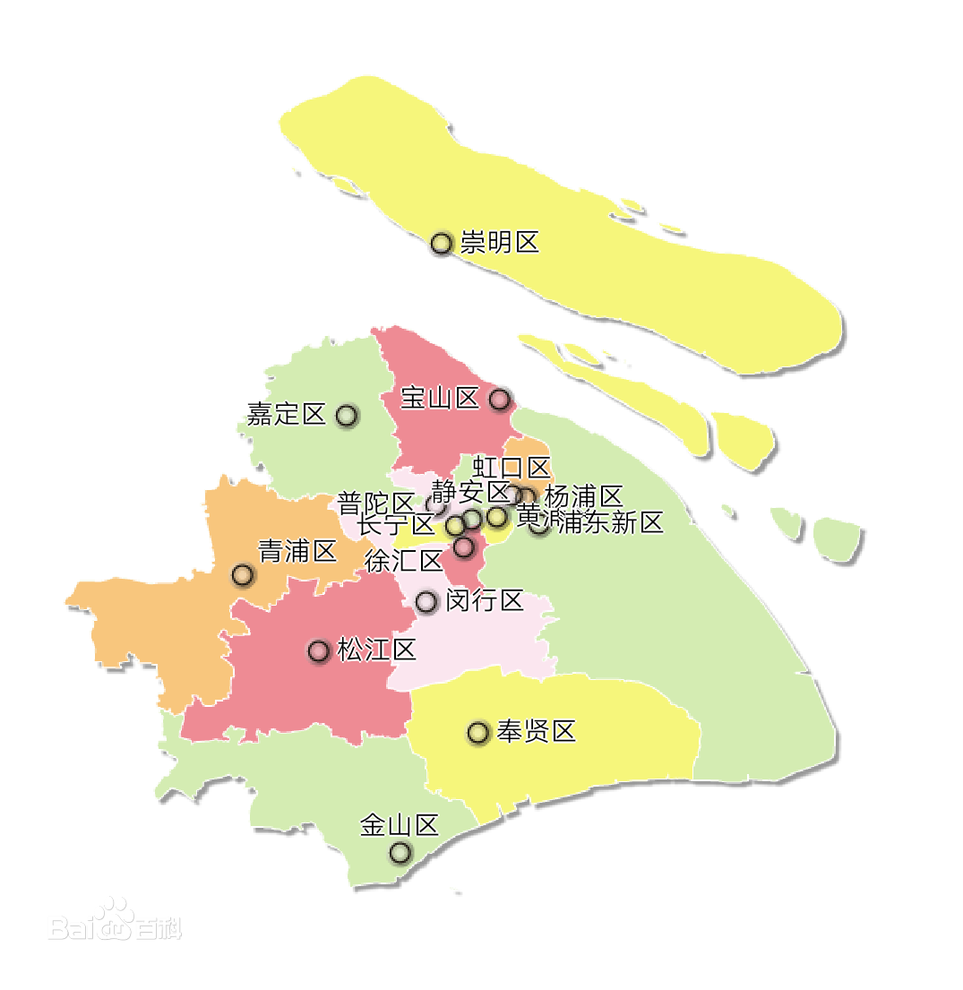
DATA DESCRIPTION
Location
Notes:
Another important feature is the location of the apartment.
Instead of longitude and latitude, here we take the administrative region that the apartment belongs to as a feature.
Let’s say Shanghai has 16 districts and each district has several neighborhoods, and we are gonna take these neighborhoods as a categorical variable. For example, this apartment is in the xx neighborhood of huangpu district.

Slide 8
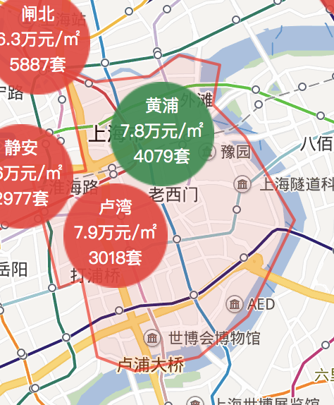
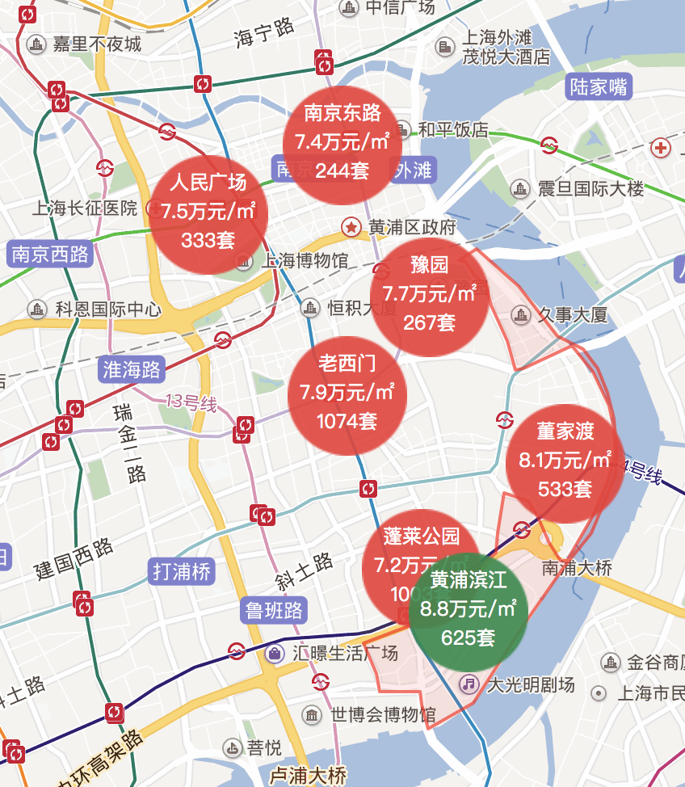
DATA DESCRIPTION
Location
Notes:
16 districts

Slide 9
DATA DESCRIPTION
Bedroom | Living room | Bathroom | Floor area
Numerical | Numerical | Numerical | Numerical
Orientation | Decoration | Subway | Location
Categorical | Categorical | Numerical | Categorical
School | Year built | Elevator | Price
Categorical | Numerical | Categorical | Numerical
Notes:
Besides,

Slide 10
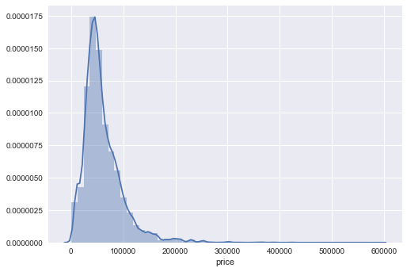
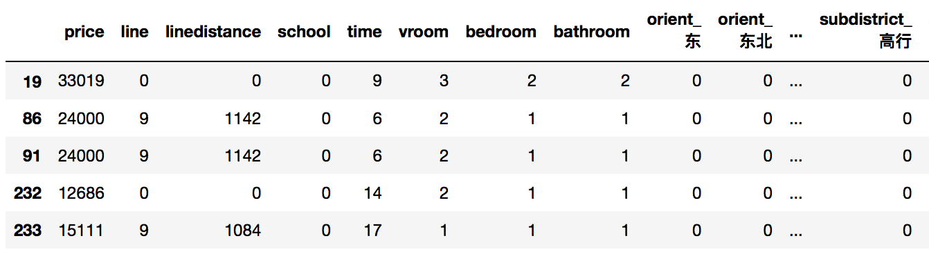
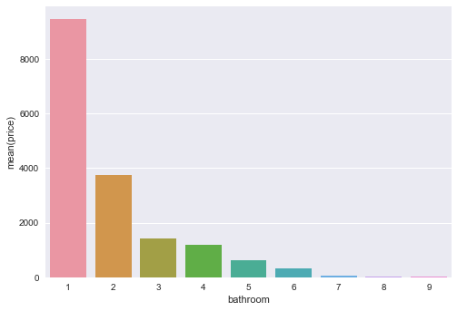
DATA DESCRIPTION
Notes:
After these analysis, we made a scraper and scrapped around 20 k rows of data. Here is what our data look like in python.
Histagram of the price,

Slide 11
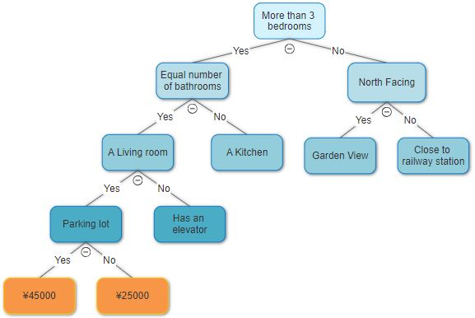
MODEL DESCRIPTION
RANDOM FOREST
A Decision Tree based on feature selection classifies the data and reaches to a conclusion
Example of a Decision Tree deciding on the price of an apartment.

Slide 12
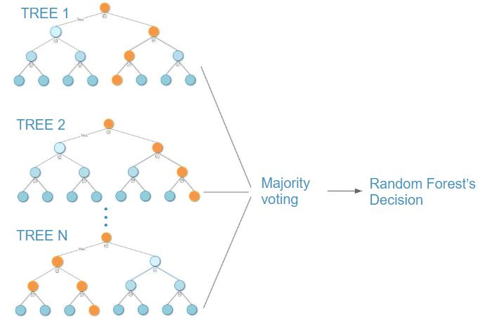
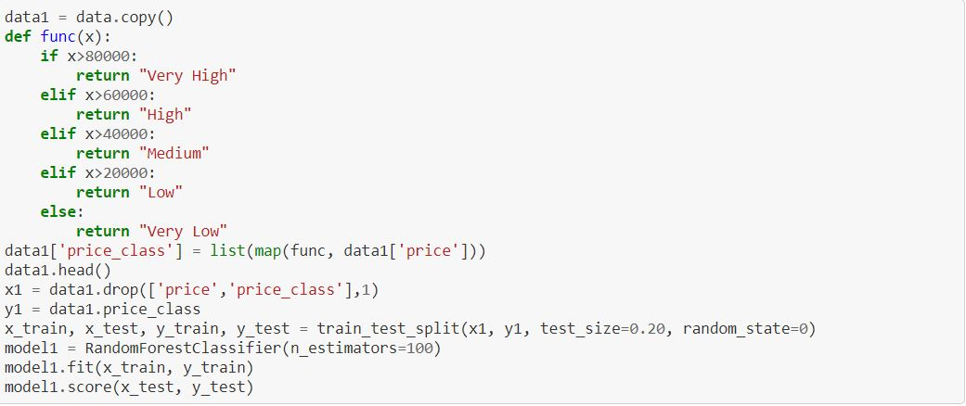
MODEL DESCRIPTION
RANDOM FOREST
Trained a model using both regressor and classifier technique.
For the regressor type we kept the trees limit to 100.
For the classifier type, we trained 2 model, one with 5 labels and one with 3 labels.

Slide 13
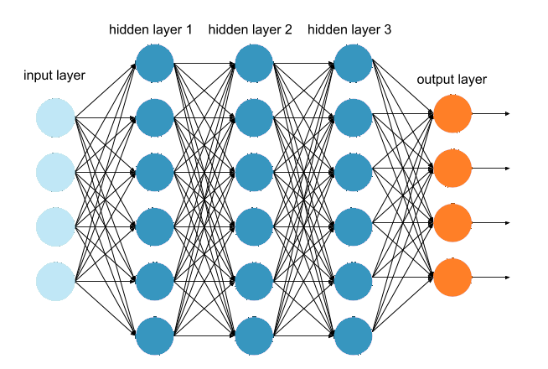
MODEL DESCRIPTION
Dense Neural Network
The Dense Neural Network model we trained comprised of three hidden layers.
The layers had 500, 300 and 100 neurons each and we used ‘tanh’ as the activation function.
Loss function used was ‘RMSE’
Trained the model in batches of 100, running it for 2000 iterations.

Slide 14
Definition of Accuracy
We use confidence interval ß
Accurate
Of Regression
|prediction - actual|<ß*actual

Slide 15
Accuracy Change along our path
Old Data
ß=15%
Accuracy 30%
Both DNN & RFR
New Data
ß=15%
Accuracy 55%
DNN
New Data
ß=15%
Accuracy
66%
RFR
New Data
Accuracy
75% with 5 labels
85% with 3 labels
RFC

Slide 16
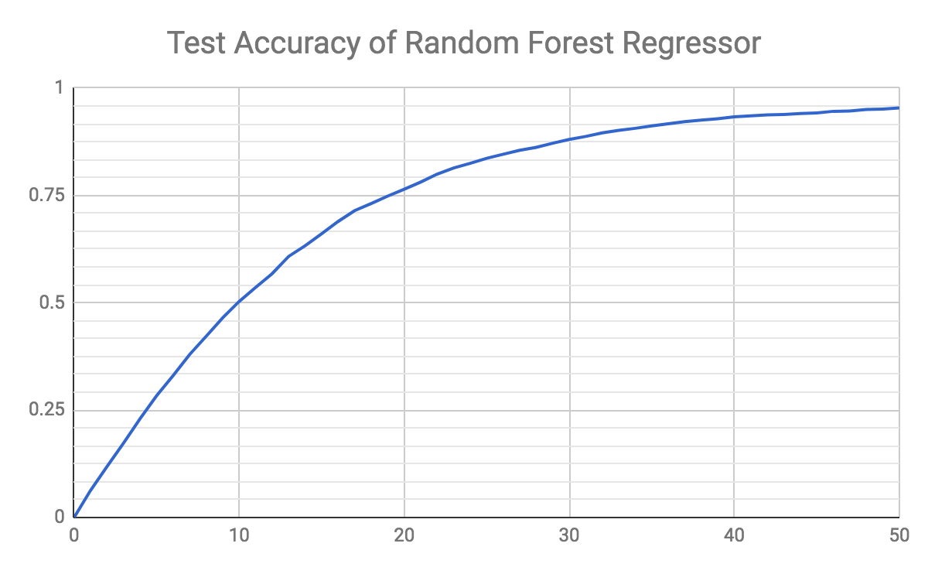
Accuracy
ß

Slide 17
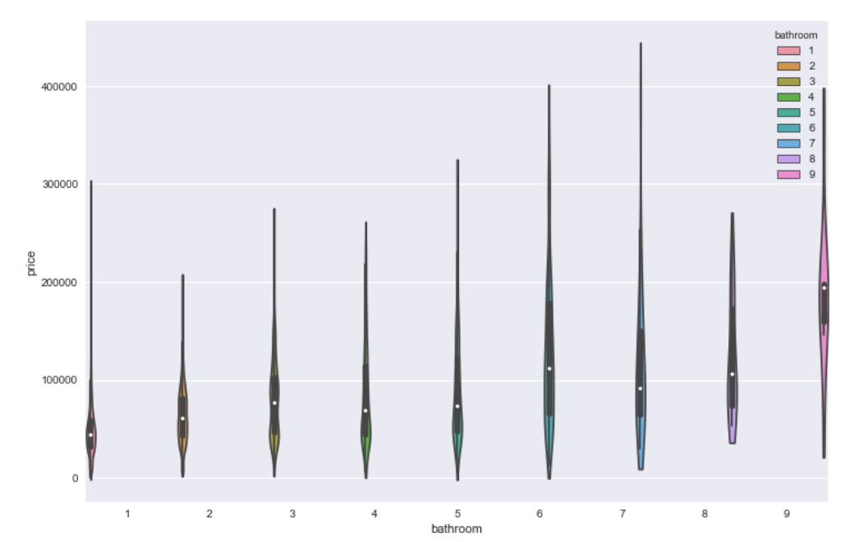

Slide 18
Price Index
(Weighted Average)
Time Series(ARIMA)
Total Price
Price Premium
( Price-Index)
RandomForest

Slide 19
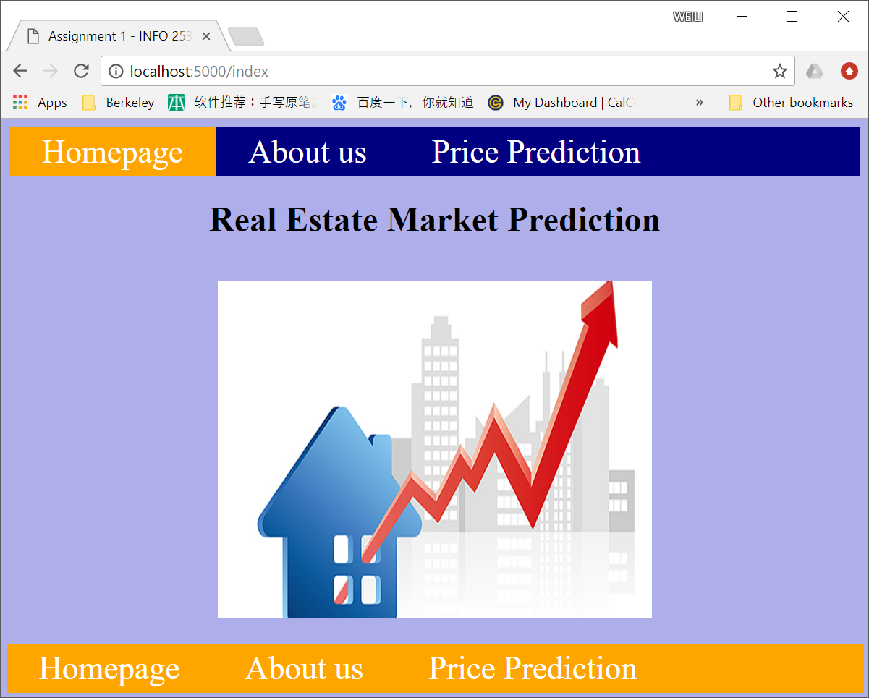
User Interface

Slide 20
Summary
Problems we solved.
How do we get to the final solutions.
Techniques we used
What to do in the future
Notes:
1.Fit the model. What feature is the most important? (landmark in the district)
2. We first tried to use the API, but request did not passed. Then scrape the data from the web page, just a few features like district, area, parking lot, green rate. We then further look into an detailed agency analysis to scrape the information to find whether the keyword like ‘gym’, ‘swimming pool’, ‘school’ is in it. But due to a lot of invalid data, we switched to another effective data source and scraped 18000 non repeated rows of data. Those features are just what we mentioned before. Then we used NN and Random Forest to get the model, compare accuracies. Last built a simple user interface.
3. Web scraping, data cleaning, modeling, web architecture

Slide 21
Future work
More beautiful User Interface
Get more data and scrape more feature to further train the model
Find the price in the past three or five years to do the time series model and price prediction

Slide 22
References
1. P.J. Brockwell and R.A. Davis, Time Series: Theory and Methods, Springer Series in Statistics (1986).
C. Chatfield, The Analysis of Time Series: Theory and Practice, Chapman and Hall (1975). Good general introduction, especially for those completely new to time series.
P.J. Diggle, Time Series: A Biostatistical Introduction, Oxford University Press(1990).
M. Kendall, Time Series, Charles Griffin (1976).
Roy E. Lowrance, Predicting the Market Value of Single-Family Residential Real Estate (01/2015)

Slide 23
THANKS!
Any questions?

